Slide 1
Lifestyle Psychiatry Harnessing The Therapeutic Power Of The Great Outdoors
Melissa Sundermann, DO, FACOI
Diplomat, Amercian Board of Lifestyle Mediicine
Fellow, American College of Lifestyle Medicine
Chair, Lifestyle Medicine Initiative, Global Wellness Instititue
Concierge Physician, Lifespan Medicine
Gia Merlo, MD, MBA, MEd
Clinical Professor of Psychiatry, NYU School of Medicine
Associate Editor, American Journal of Lifestyle Medicine
Founding Chair, American Psychiatric Association Lifestyle Psychiaty Caucus
Fellow, American College of Lifestyle Medicine

Slide 2
No Disclosures

Slide 3
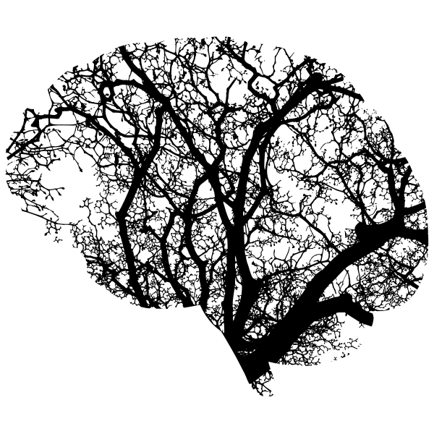
Learning Objectives
1. Describe the principles of lifestyle psychiatry and its application in promoting mental health and longevity through nature-based interventions.
2. Evaluate the scientific evidence supporting the therapeutic benefits of nature exposure on mental health, stress reduction, and cognitive function in the context of longevity.
3. Develop practical skills in prescribing personalized nature interventions within clinical practice to enhance patient outcomes related to mental resilience and healthy aging.

Slide 4
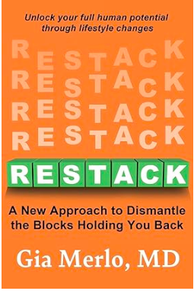
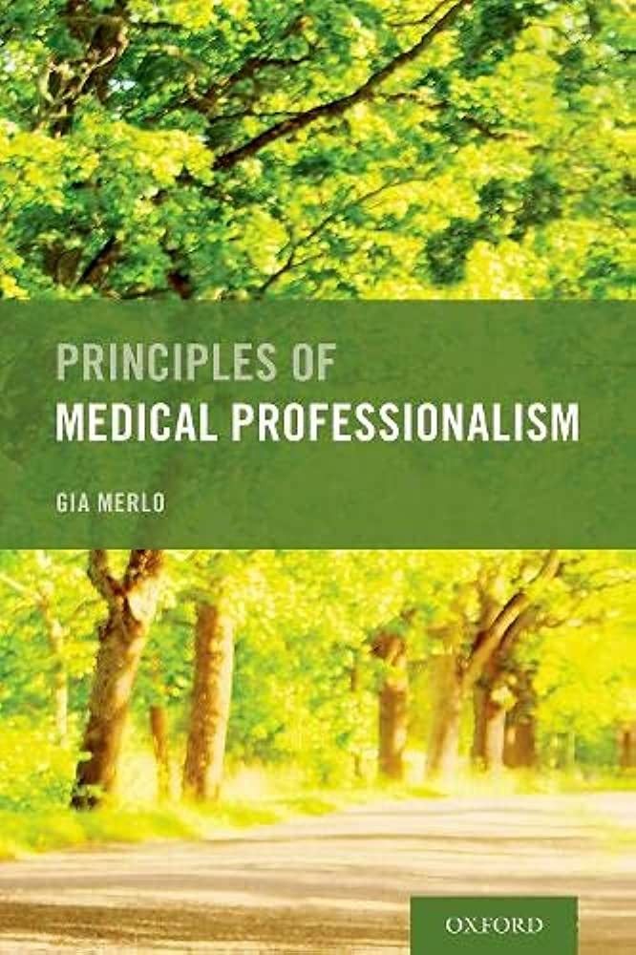
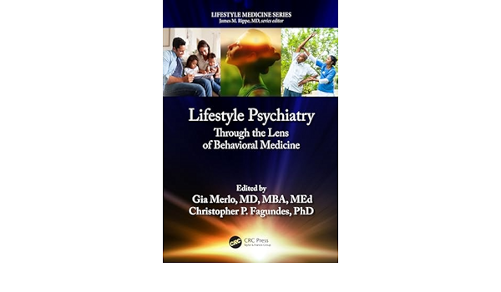
GIA MERLO MD, MBA, MEd
Clinical Professor of Psychiatry, NYU Grossman School of Medicine
APA Presidential Workgroup on Lifestyle Psychiatry, chair
APA Lifestyle Psychiatry Caucus, founding chair
Associate Editor, American Journal of Lifestyle Medicine
www.giamerlo.com
Forthcoming

Slide 5
WHAT IS LIFESTYLE PSYCHIATRY?
It is a subfield of Lifestyle Medicine

Slide 6
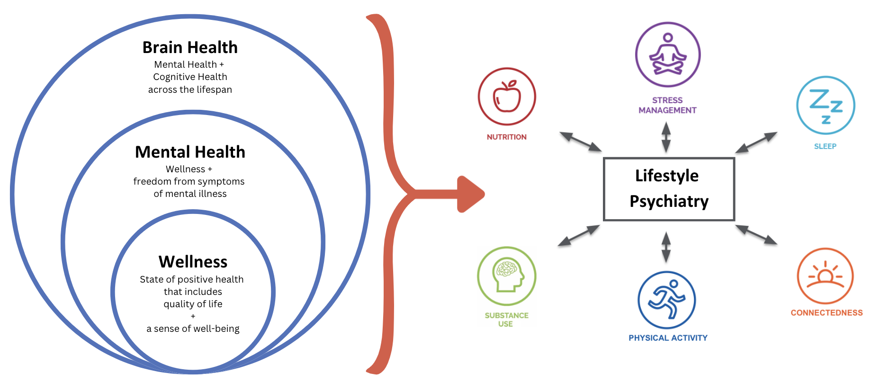
LIFESTYLE PSYCHIATRY IS BRAIN HEALTH
Merlo et al., 2024; Merlo & Vela, 2021; Burke & Dunne, 2022
Notes:
Lifestyle psychiatry is an evidence-based field that employs a conventional medicine lens (as opposed to complementary/alternative medicine) to psychopathology and focuses on lifestyle interventions that can often be used as adjuncts to decreased symptoms of syndromal and subsyndromal states and at times may prevent and treat chronic diseases. Lifestyle psychiatry can be seen as a psychiatric approach to lifestyle medicine, which is an evidence-based approach to helping individuals and families adopt and sustain healthy behaviors in preventing, treating, and reversing diseases.
As we’re thinking about lifestyle psych and these pillars around mental health
Bidirectionality of mental and physical health
Each of these pillars are affected by our brain and mental health
MENTION 6 pillars
Consensus on exercise?
Today, our talk is going to focus on the nutrition pillar, specifically a subset within gut microbiome

Slide 7
EVOLUTION OF THE MEDICAL FIELD OF PSYCHIATRY
Gia Merlo, Restack, October 2024

Slide 8
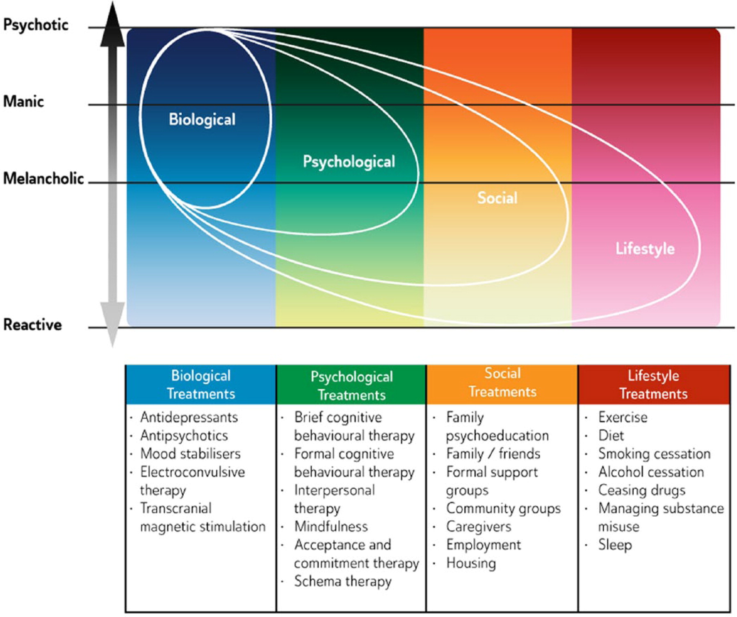
BIOPSYCHOSOCIAL-LIFESTYLE MODEL
Malhi et al., 2015 https://pubmed.ncbi.nlm.nih.gov/26643054/
Notes:
https://pubmed.ncbi.nlm.nih.gov/26643054/
“The BPSL Model provides a useful framework for understanding the factors that contribute to the development of mood disorders and for planning clinical management. It encompasses biological, psychological and social perspectives alongside lifestyle factors and is therefore referred to as the BPSL Model. Typically mood disorders arise from factors from more than one domain. Consequently a broad range of treatments are usually needed to satisfactorily treat mood disorders.”
https://drive.google.com/file/d/1gqr7OQ-xGQr6qxpnG4FqQYVj410wlnIH/view?usp=drive_link

Slide 9
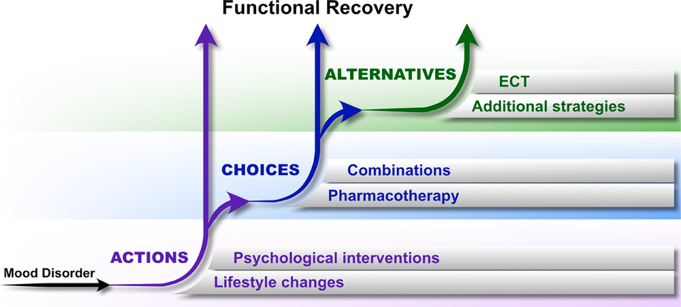
ROYAL AUSTRALIAN AND NEW ZEALAND COLLEGE OF PSYCHIATRISTS 2020 GUIDELINES FOR MOOD DISORDERS
Malhi et al., 2020; The 2020 Royal Australian and New Zealand College of Psychiatrists clinical practice guidelines for mood disorders - Gin S Malhi, Erica Bell, Darryl Bassett, Philip Boyce, Richard Bryant, Philip Hazell, Malcolm Hopwood, Bill Lyndon, Roger Mulder, Richard Porter, Ajeet B Singh, Greg Murray, 2021 (sagepub.com)
Notes:
demonstrates the biopsychosocial and lifestyle elements of the MDcpg2020 treatment framework, applicable to all phases of all mood disorders. Three additional features are noteworthy. First, the framework shows that lifestyle changes and psychological interventions are foundational in the treatment of mood disorders. These are both recommended Actions – essentially non-negotiable and to be discussed with all patients. Lifestyle changes include smoking cessation, limiting alcohol and substance misuse, instituting exercise, sleep hygiene and a healthy diet. An evidence-informed innovation in MDcpg2020 is the prioritisation of psychological intervention as a foundational action in the treatment of all mood disorders: all patients should be offered structured psychological treatment. Second, clinician Choices are then layered on top of this base. Choices begin with straightforward pharmacotherapy, traditionally the focus of mood disorder management, but seen here as resting on the foundation of lifestyle changes and psychological intervention. Treatment may then need to progress to permutations (combinations and augmentation strategies), and possibly further to Alternatives, including physical treatments such as ECT. Finally, the schematic shows how functional recovery can be achieved at many steps along this process, with ‘earlier’ functional recovery precluding the need for more invasive intervention.The Actions, Choices and Alternatives framework for the management of mood disorders. This framework includes three components. (1) Actions—form the basic foundation of management and should be instituted whenever possible. They include lifestyle changes and psychological interventions. (2) Choices—involve those pharmacotherapeutic options that are recommended and should be trialled initially. They can also be used as part of more complex regimens involving combinations and alternative treatment strategies. (3) Alternatives—include complex medication strategies and physical treatments such as ECT. It is important to note that functional recovery can be achieved at any point in this process, and the aim should be to achieve this as quickly and effectively as possible.
Malhi, G. S., Bell, E., Singh, A. B., Bassett, D., Berk, M., Boyce, P., ... & Murray, G. (2020). The 2020 Royal Australian and New Zealand College of Psychiatrists clinical practice guidelines for mood disorders: major depression summary. Bipolar disorders, 22(8), 788-804.
https://drive.google.com/file/d/1-669TqboLN1mfmbSkRnkVKOTKbK4DIj4/view?usp=drive_link

Slide 10
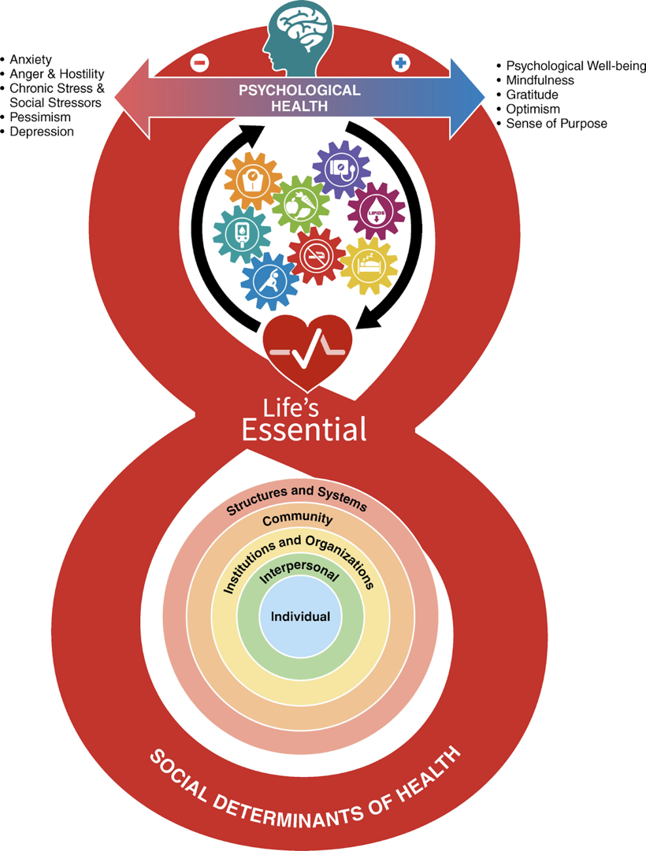
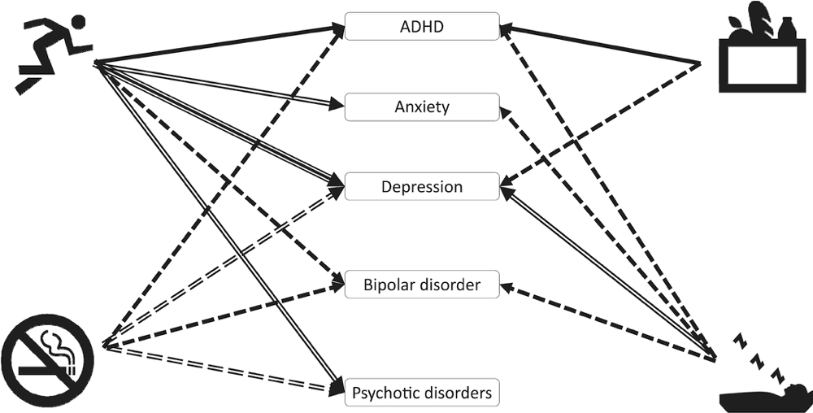
AMERICAN HEART ASSOCIATION’S LIFE’S ESSENTIAL 8
LIFESTYLE FACTORS IN THE PREVENTION
AND TREATMENT OF
MENTAL ILLNESS
Anxiety
Anger & Hostility
Chronic Stress & Social Stressors
Pessimism
Depression
The dashed line indicates evidence for protective benefit from either prospective meta‐analyses (P‐MAs) or Mendelian randomization studies (MRs).
The double‐dashed line indicates evidence for protective effects from both P‐MAs and MRs.
The solid line indicates evidence for efficacy in treatment of mental illness from MAs of randomized controlled trials (RCTs).
The double solid line indicates convergent evidence from MRs or P‐MAs with MAs of RCTs.
The treble solid line indicates convergent evidence from all three (P‐MAs + MRs + MAs of RCTs).
Firth et al., World Psychiatry, 2020; https://onlinelibrary.wiley.com/doi/10.1002/wps.20773
Notes:
This figure summarizes the evidence with the dashed line showing protective benefits from prospective meta-analysis
To the solid lines showing efficacy in treatment from RCTs.
The double and triple solid lines showing convergent evidence from randomization studies and meta-analyses.
From here, this figure only speaks to 4 of the 6 pillars of Lifestyle Psychiatry, this is the level of compelling evidence at 2020
The dashed line indicates evidence for protective benefit from either prospective meta‐analyses (P‐MAs) or Mendelian randomization studies (MRs).
The double‐dashed line indicates evidence for protective effects from both P‐MAs and MRs.
The solid line indicates evidence for efficacy in treatment of mental illness from MAs of randomized controlled trials (RCTs).
The double solid line indicates convergent evidence from MRs or P‐MAs with MAs of RCTs.
The treble solid line indicates convergent evidence from all three (P‐MAs + MRs + MAs of RCTs).
ADHD – attention‐deficit/hyperactivity disorder.
https://onlinelibrary.wiley.com/doi/10.1002/wps.20773
Firth, J., Solmi, M., Wootton, R. E., Vancampfort, D., Schuch, F. B., Hoare, E., Gilbody, S., Torous, J., Teasdale, S. B., Jackson, S. E., Smith, L., Eaton, M., Jacka, F. N., Veronese, N., Marx, W., Ashdown-Franks, G., Siskind, D., Sarris, J., Rosenbaum, S., Carvalho, A. F., … Stubbs, B. (2020). A meta-review of "lifestyle psychiatry": the role of exercise, smoking, diet and sleep in the prevention and treatment of mental disorders. World psychiatry : official journal of the World Psychiatric Association (WPA), 19(3), 360–380. https://doi.org/10.1002/wps.20773
https://drive.google.com/file/d/1b-ZE9lJ96MKbdqTbmJN7-L9YEUPqtbmk/view?usp=sharing

Slide 11
DISEASES ASSOCIATED WITH DYSBIOSIS OF THE GUT MICROBIOTA
Neurodegenerative disorders
Psychiatric disorders
Anxiety & Depression
Schizophrenia
Autism spectrum disorder
Bipolar disorder
Multiple sclerosis
Parkinson’s disease
Cardiovascular disease
Coronary artery disease
Hypertension
Metabolic disorders
Metabolic syndrome
Obesity
Types 1 and 2 diabetes
Intestinal disorders
Inflammatory bowel disease
Crohn’s disease
Ulcerative colitis
Irritable bowel syndrome
Celiac disease
Pregnancy-related conditions
Gestational hypertension
Gestational diabetes
Carding et al., 2015; Cekanaviciute et al., 2017; Dunlop et al., 2015; Fond et al., 2015;
Li et al., 2017; Sampson et al., 2016, Senthong et al., 2016; Tai et al., 2015
Notes:
The microbiome is implicated in a variety of disorders. Much recent research has found evidence for a role for the microbiome in many diseases including skin, metabolic, and cardiovascular disease, as well as cancer, infection, and neurodegenerative and psychiatric disorders.
Carding et al: https://drive.google.com/file/d/17cMIR1MdbZoqUJbpdQI2VwvxanGCGbEU/view?usp=sharing
Cekanaviciute et al., 2017: https://drive.google.com/file/d/1otY1IlFrvWVdfRxHP2Bh11pkDc25LT0E/view?usp=sharing
Dunlop et al., 2015: https://drive.google.com/file/d/1ExpWOYwbtdiWzzSwKGQN4HkqIdjXdA9n/view?usp=sharing
Fond et al., 2015: https://drive.google.com/file/d/1twRegc9pCemcwfgAL0G2LhdKJX9Iisgw/view?usp=sharing
Li et al., 2017: https://drive.google.com/file/d/11-axgFWSaM6Pjji4MLWE1d1ZPfF2jjiv/view?usp=sharing
Sampson et al., 2016: https://drive.google.com/file/d/1QLaHaLV3dC_deM7UwTLGtFznTX1KA_4u/view?usp=sharing
Senthong et al., 2016: https://drive.google.com/file/d/11DeZssecJv3FZh-asF2v0CzMBXq5oF_x/view?usp=sharing
Tai et al., 2015: https://drive.google.com/file/d/1Vt4TftjQg9-GScjZpe4wdwSlM7Fy6aKf/view?usp=sharing

Slide 12
WHAT IS THE NUMBER NEEDED TO TREAT (NNT) FOR MAJOR DEPRESSIVE DISORDER?
TCAs – 6 to 16 (median 9)
SSRI – 7 to 8 (median 8)
Psychotherapy – 2.5 ( 3.5 in low
risk of bias studies)
Exercise – 2 (2.8 in low-risk
bias studies)
MDD only – 1.9
Supervised – 1.6
Arroll et al., 2023, https://doi.org/10.1002/wps.21057
12

Slide 13
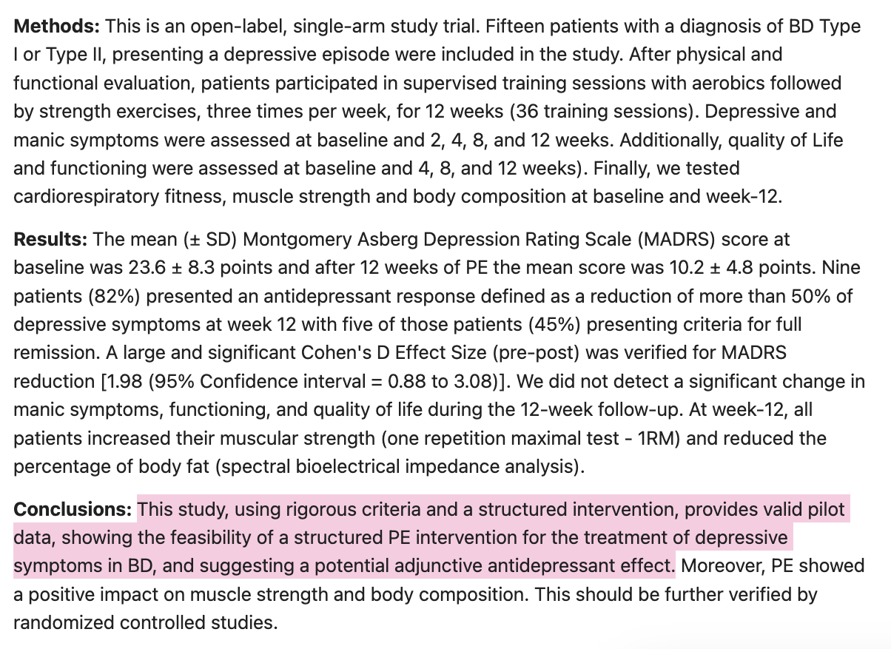
15 patients with bipolar disorder
Showing physical activity beneficial for treating depressive symptoms
Montgomery Asberg Depression Rating Scale decreased by more than 50% at week 12
82% of patients experienced a reduction in depressive symptoms
Lafer et al., 2023; https://pubmed.ncbi.nlm.nih.gov/37085592/
13
Notes:
A study involving 15 patients with bipolar disorder (BD) found that structured physical exercise (PE) could potentially be beneficial for treating depressive symptoms. The patients were supervised to perform aerobics and strength exercises three times per week for 12 weeks. The mean Montgomery Asberg Depression Rating Scale score was reduced by more than 50% at week 12, with 82% of the patients experiencing a reduction. However, there was no significant change in manic symptoms, functioning, or quality of life. The study provides valid pilot data, demonstrating the feasibility of PE as a treatment for depressive symptoms in BD and suggesting a potential adjunctive antidepressant effect.
Further research is needed to confirm these findings.
https://pubmed.ncbi.nlm.nih.gov/37085592/

Slide 14
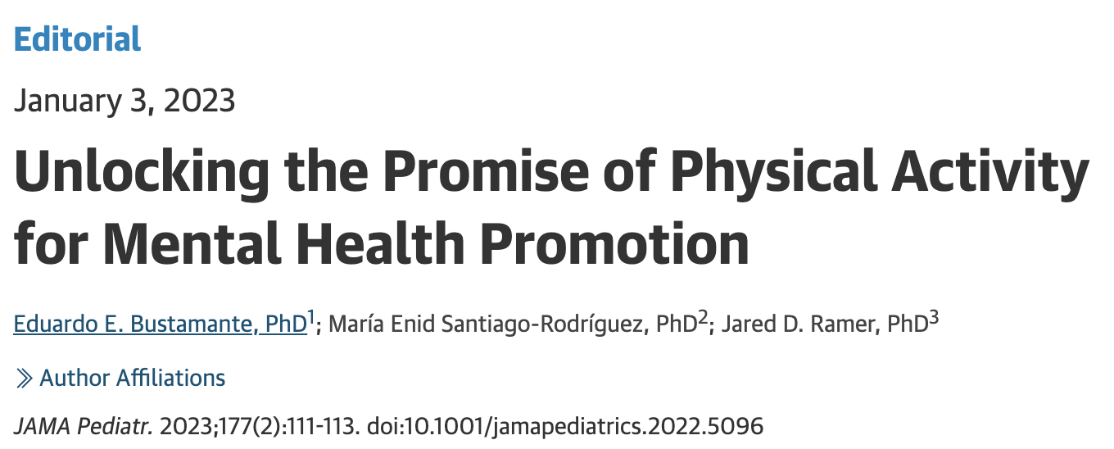
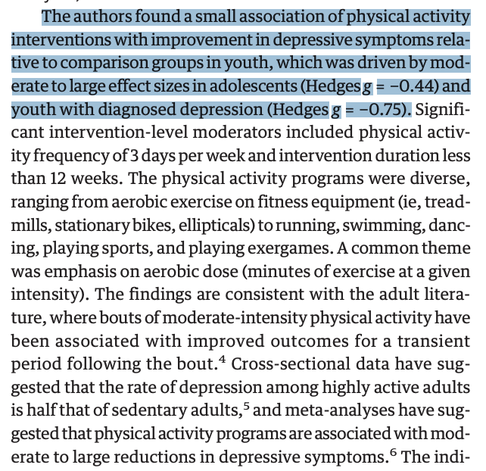
PHYSICAL ACTIVITY AND MENTAL HEALTH IN PEDIATRIC PATIENTS
JAMA Pediatrics systematic review and meta-analysis commentary about improvement of depressive symptoms with physical activity in youth
Included 2400 youths in 20 RCTs
Bustamante et al., 2023; https://pubmed.ncbi.nlm.nih.gov/36595261/
14
Notes:
Recchia et al. published a systematic review and meta-analysis in JAMA Pediatrics, extending the evidence on the health benefits of physical activity. The review included data from over 2400 youth from over 20 randomized clinical trial and quasi-experimental design studies. This 2023 study by Bustamante is timely, aligning with the rise of mental health disorders in adolescents, and uses rigorous methods like random-effects models and risk-of-bias assessment.
The authors found a small association of physical activity interventions with improvement in depressive symptoms relative to comparison groups in youth, driven by moderate to large effect sizes in adolescents and youth with diagnosed depression.
***
https://pubmed.ncbi.nlm.nih.gov/36595261/

Slide 15
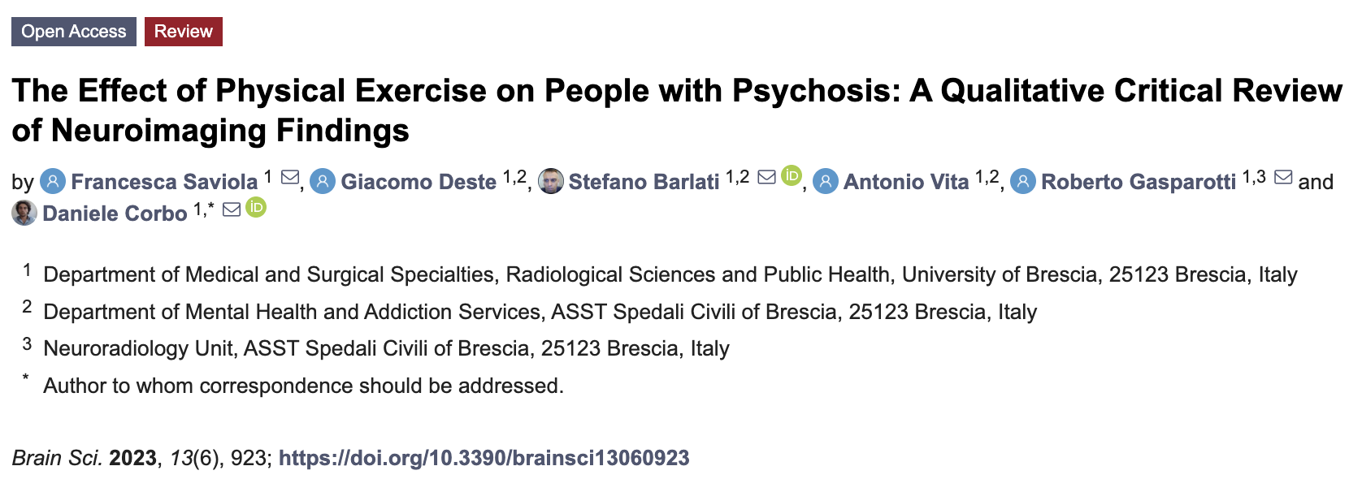
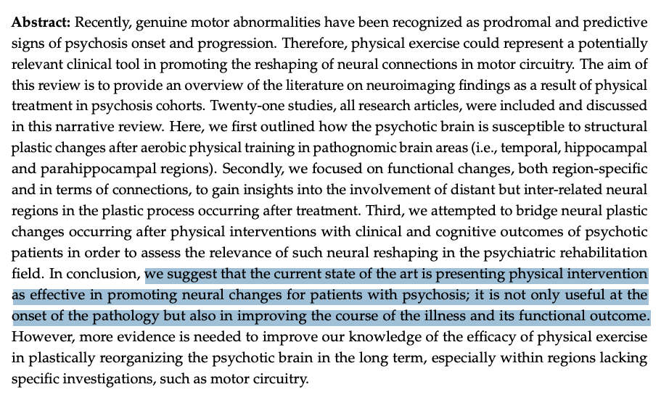
21 studies reviewed
Psychotic brain able to make structural and functional changes after aerobic training
Saviola et al., 2023; https://www.ncbi.nlm.nih.gov/pmc/articles/PMC10295951/
15
Notes:
Motor abnormalities are predictive signs of psychosis onset and progression. Physical exercise could be a clinical tool for reshaping neural connections in motor circuitry. This review discusses 21 studies on neuroimaging findings from physical treatment in psychosis cohorts. It highlights the psychotic brain's susceptibility to structural and functional changes after aerobic physical training. The review suggests that physical intervention is effective in promoting neural changes for psychotic patients, improving their illness course and functional outcome. More evidence is needed to understand its long-term efficacy.
https://www.ncbi.nlm.nih.gov/pmc/articles/PMC10295951/

Slide 16
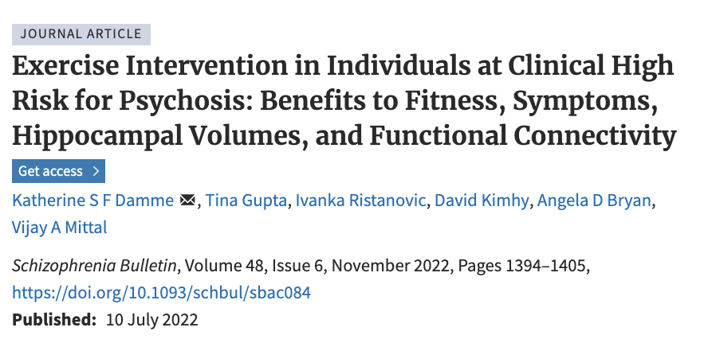
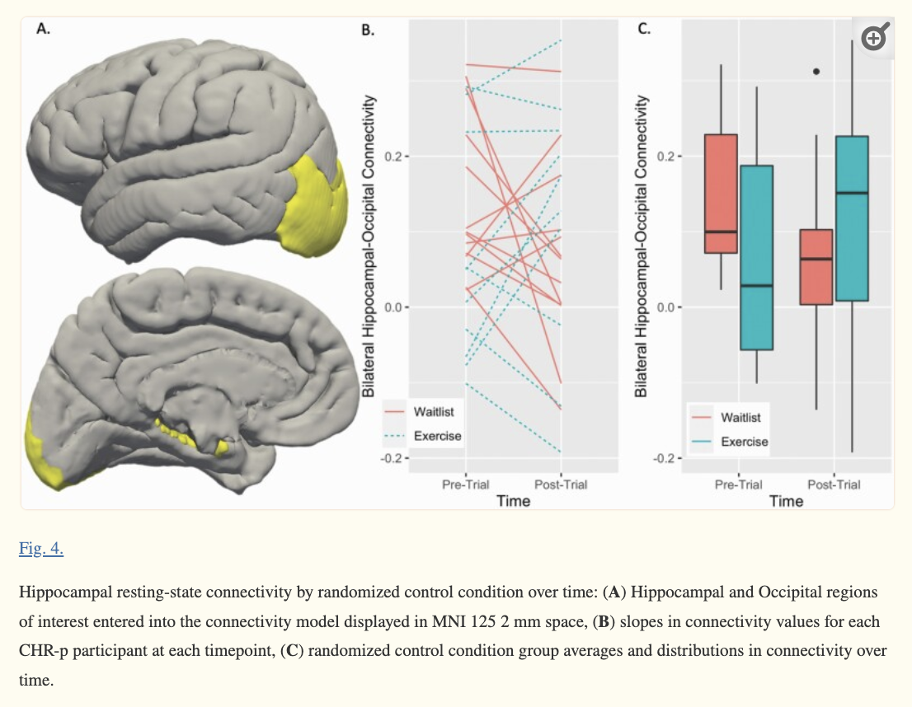
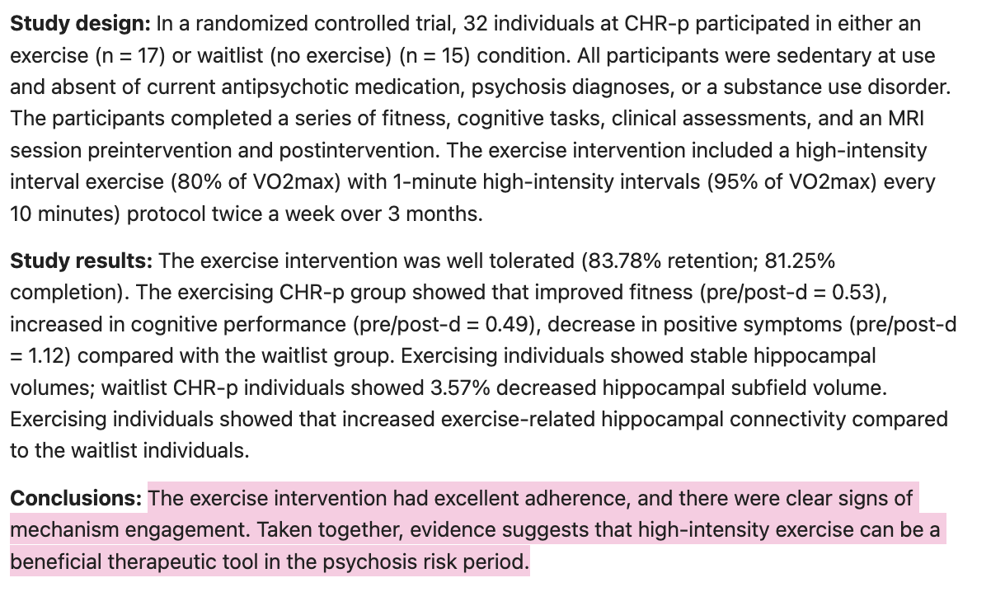
32 participants
Showed HIIT decreased positive symptoms of schizophrenia
Damme et al., 2022; https://pubmed.ncbi.nlm.nih.gov/35810336/
16
Notes:
This study investigates the impact of exercise on individuals at high risk for psychosis (CHR-p), who are less fit and have hippocampal abnormalities. The study involved 32 participants who participated in either an exercise or waitlist condition. The exercise intervention included a high-intensity interval exercise twice a week for three months. Results showed improved fitness, increased cognitive performance, and decreased positive symptoms compared to the waitlist group. Exercising individuals also showed stable hippocampal volumes and increased exercise-related hippocampal connectivity. The study suggests high-intensity exercise can be a beneficial therapeutic tool during the psychosis risk period.
https://pubmed.ncbi.nlm.nih.gov/35810336/

Slide 17
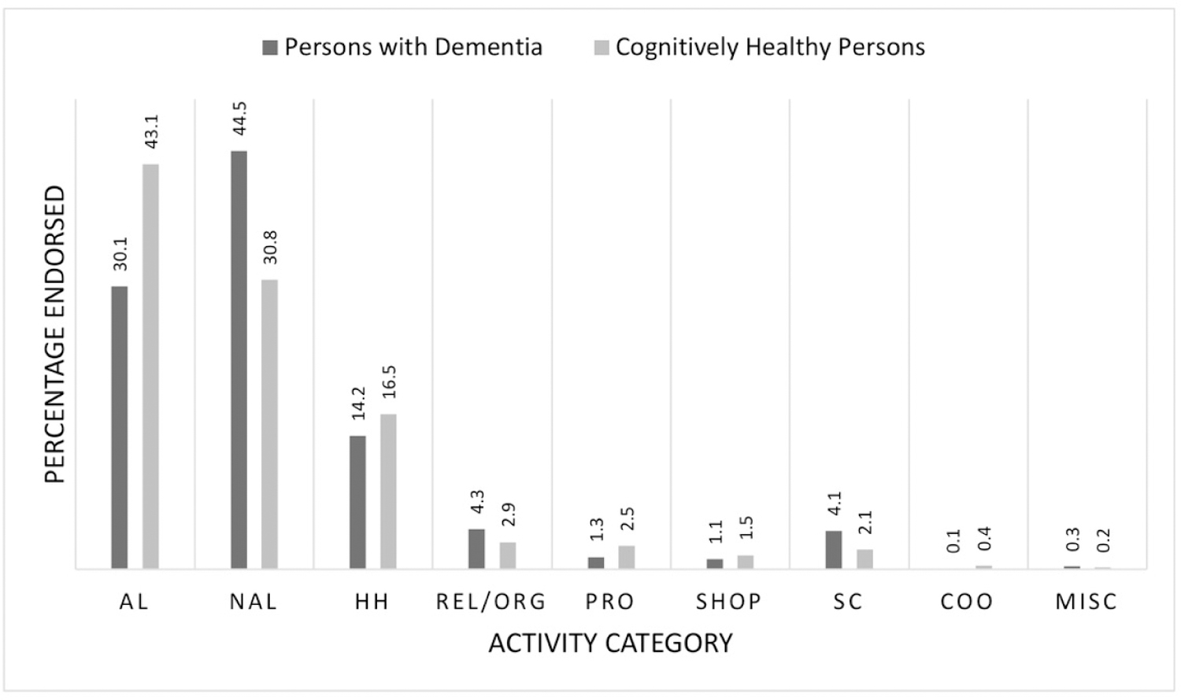
PURPOSE IN LIFE AND BRAIN HEALTH:
ITS SIGNIFICANCE WITH OLDER COMMUNITIES
6000 participants with and without dementia
Engaging in a favorite activity over the past year positively associated with:
Memory
Emotional well-being
Functional status
Physical health
Figure 1. Category of favorite activity by cognitive status. Note. AL = active leisure; NAL = non-active leisure; HH = household; REL/ORG = religious and organizational; PRO = productive; SHOP = shopping; SC = self-care; COO = care of others; MISC = other miscellaneous.
Regier et al., 2022; https://www.ncbi.nlm.nih.gov/pmc/articles/PMC8448794/#:~:text=While%20beneficial%20to%20all%20participants,functional%20status%2C%20and%20physical%20health.
17
Notes:
For cognitively healthy people (CHP), engagement in one’s favorite activity over the past year positively affected multiple domains, including memory, emotional well-being, functional status, and physical health. This suggests a potential preventive or ameliorating effect of activity engagement, consistent with previous studies. For persons living with dementia (PLWD), engagement over the past year had favorable associations with depression and functional health. These findings suggest that ensuring that people can engage in activities as they age, regardless of cognitive status, is critical for well-being.
--
**
https://www.ncbi.nlm.nih.gov/pmc/articles/PMC8448794/#:~:text=While%20beneficial%20to%20all%20participants,functional%20status%2C%20and%20physical%20health.
look at harvard study
https://drive.google.com/file/d/1IwUwZ6CM3P2CPsdiyAfG4R268ua3Srjo/view?usp=sharing
[image on the bottom right]
Figure 1. Category of favorite activity by cognitive status. Note. AL = active leisure; NAL = non-active leisure; HH = household; REL/ORG = religious and organizational; PRO = productive; SHOP = shopping; SC = self-care; COO = care of others; MISC = other miscellaneous.
https://drive.google.com/file/d/1psR-YAxcVZzHeOR-4Edbz0VJ_ibeDlwe/view?usp=sharing
For cognitively healthy people (CHP) engagement in one’s favorite activity over the past year positively affected multiple domains, including memory, emotional well-being, functional status, and physical health. This suggests a potential preventive or ameliorating effect of activity engagement, consistent with previous studies (Ashby-Mitchell et al., 2017; Klinedinst & Resnick, 2016). For persons living with dementia (PLWD), engagement over the past year had favorable associations with depression and functional health. These findings suggest that ensuring that people can engage in activities as they age, regardless of cognitive status, is critical for well-being.

Slide 18
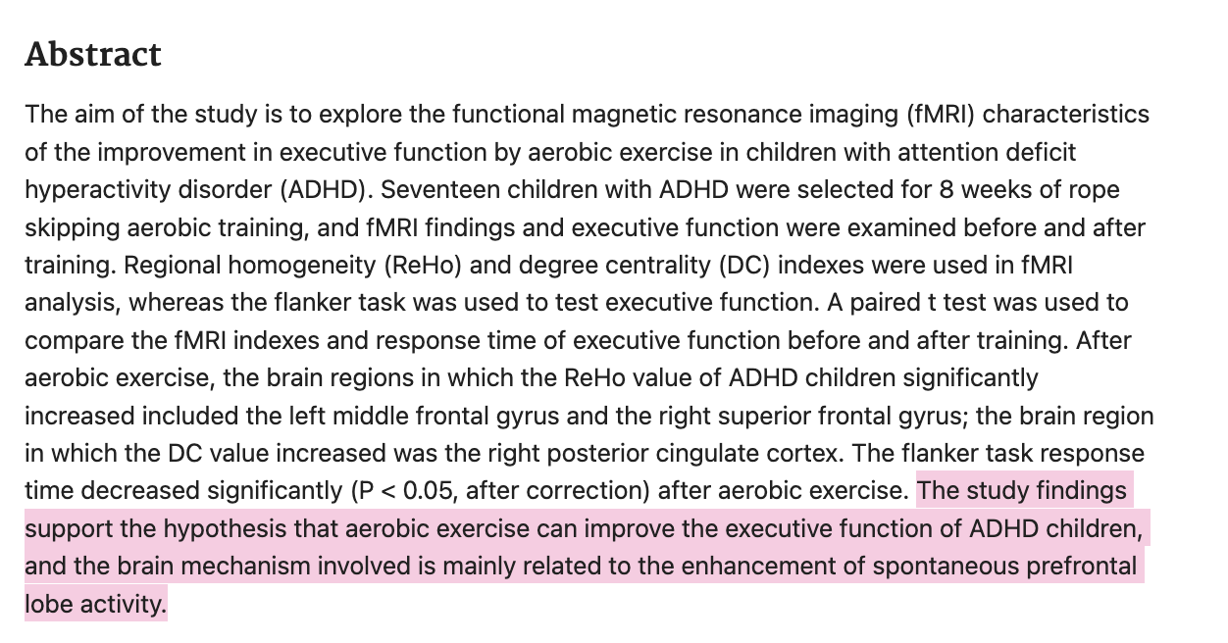
17 children with ADHD over 8 weeks of aerobic exercise (with fMRI studies before and after)
With aerobic activity:
Found improved executive function
Decreased response time
Jiang et al., 2022; https://pubmed.ncbi.nlm.nih.gov/35274372/
18
Notes:
The study investigates the impact of aerobic exercise on executive function in children with ADHD. Seventeen children were trained for 8 weeks, and fMRI findings were analyzed before and after the training. Results showed that aerobic exercise significantly improved executive function in the left middle frontal gyrus and right superior frontal gyrus, and decreased response time in the right posterior cingulate cortex.
**
https://pubmed.ncbi.nlm.nih.gov/35274372/

Slide 19
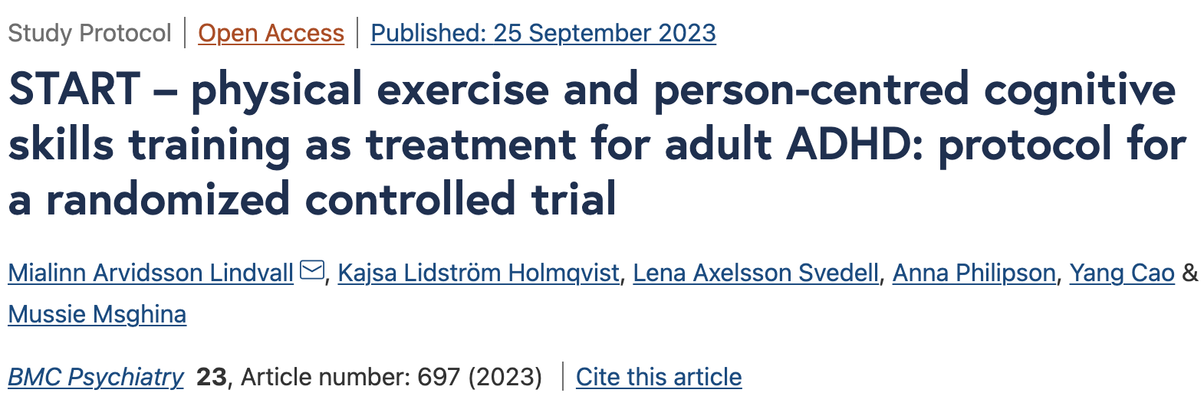
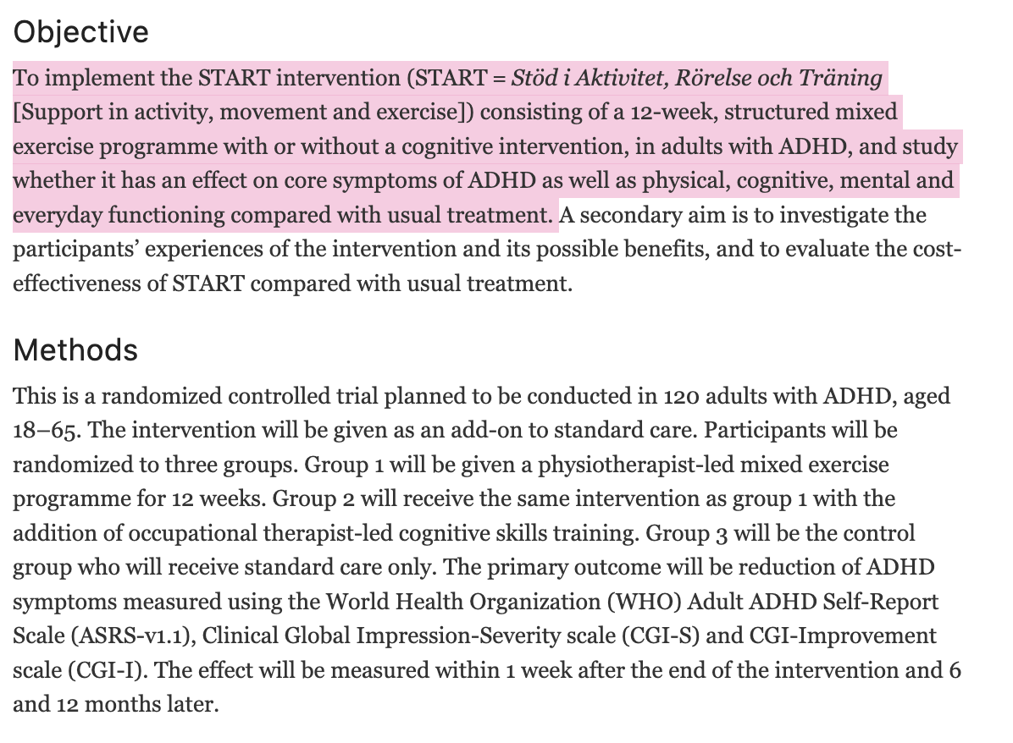
RCT with 120 adults with ADHD
START program is a 12-week structured exercise program, with or without cognitive skills training
Final results in fall 2024
Lindvall et al., 2023; START – physical exercise and person-centred cognitive skills training as treatment for adult ADHD: protocol for a randomized controlled trial | BMC Psychiatry | Full Text (biomedcentral.com)
Notes:
Starting to talk about this and study in progress
Regular physical activity positively impacts ADHD core symptoms in children and adolescents, but there is a lack of evidence on its effect on adults. People with ADHD face challenges in everyday life, such as inattention, impulsivity, and hyperactivity, but exercise is less. Structured cognitive skills training can improve everyday functioning, but its contribution to increased physical activity and maintaining routines is not yet studied. The START intervention, a 12-week structured exercise program, with or without cognitive skills training, could be a valuable addition to ADHD treatment options. The study aims to describe participants' experiences and evaluate its cost-effectiveness.
Data collection began in March 2021, the researchers are expecting final results by fall 2024
https://bmcpsychiatry.biomedcentral.com/articles/10.1186/s12888-023-05181-1#:~:text=The%20main%20aim%20is%20to,with%20treatment%20as%20usual%20(TAU)

Slide 20
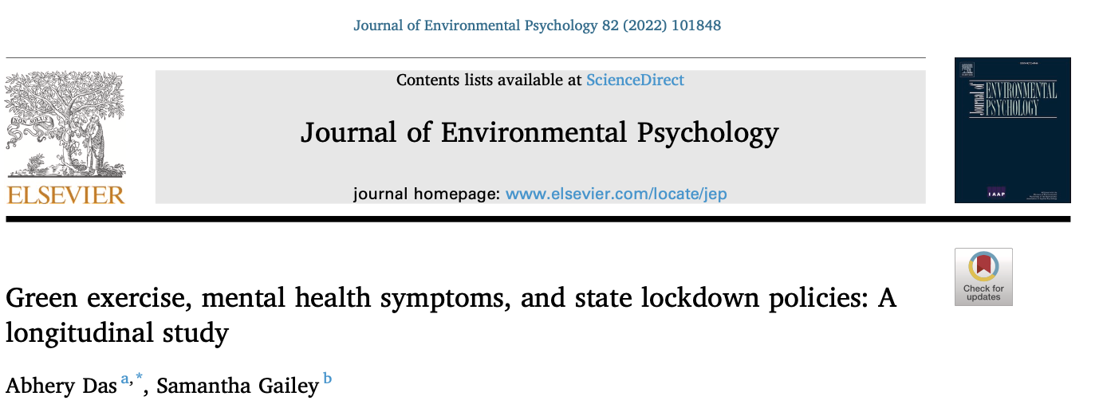
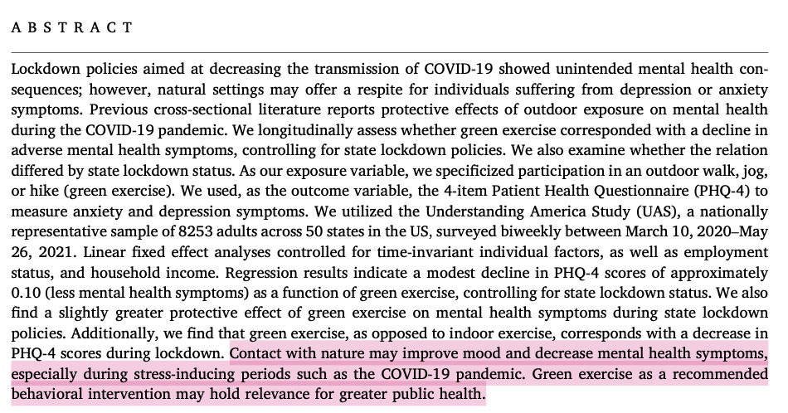
GREEN EXERCISE AND MENTAL HEALTH
Green exercise during COVID-19 showed PHQ-4 scores (anxiety and depression)
Das & Gailey, 2022; https://pubmed.ncbi.nlm.nih.gov/35854909/
20
Notes:
Green exercise during lockdown policies may reduce mental health symptoms, according to a study. The study found a modest decline in PHQ-4 scores, with a slightly greater protective effect during lockdown. The study suggests green exercise as a recommended behavioral intervention for public health.
**
https://pubmed.ncbi.nlm.nih.gov/35854909/

Slide 21
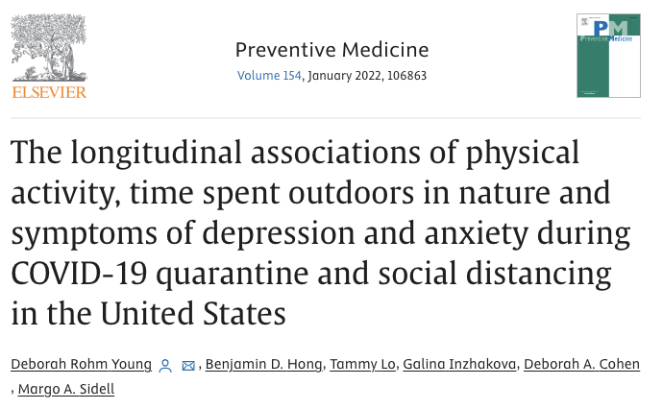
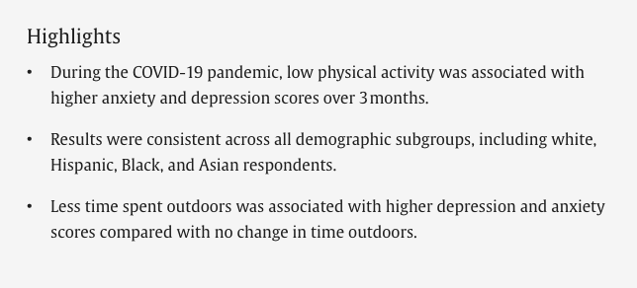
GREEN EXERCISE AND MENTAL HEALTH
20,000 adults during COVID-19
Low physical activity associated with higher anxiety and depression
Rohm Young et al., 2022; https://www.sciencedirect.com/science/article/pii/S0091743521004369
Notes:
The COVID-19 pandemic has increased depression and anxiety, while decreasing physical activity. A study of 20,000 adults found that less outdoor time and less physical activity were associated with higher depression and anxiety, particularly in younger age groups. The study suggests continued physical activity during emergencies.
**
https://www.sciencedirect.com/science/article/pii/S0091743521004369

Slide 22
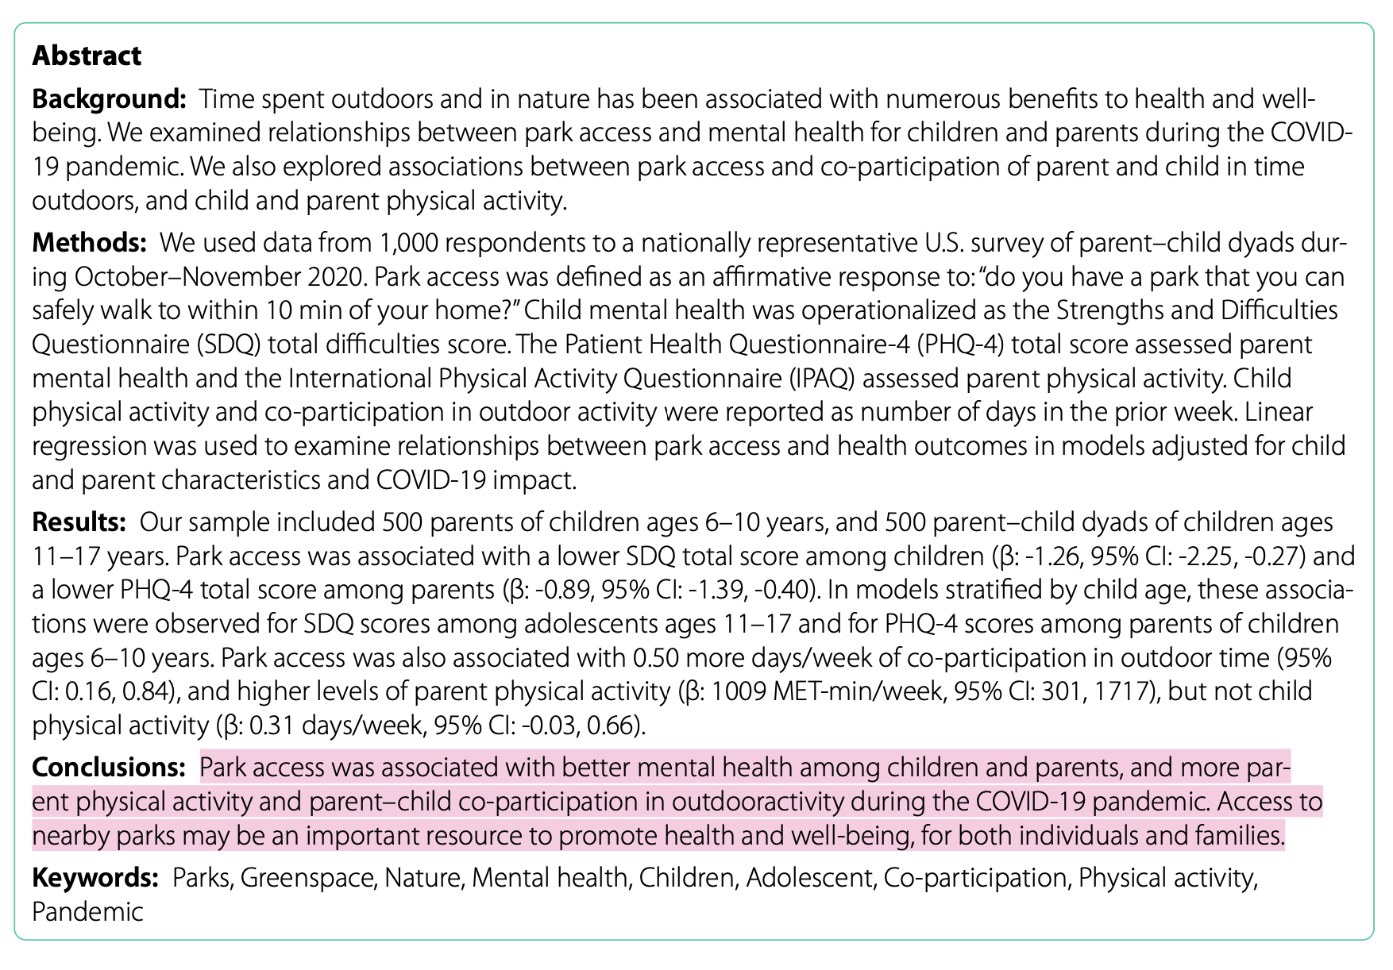
GREEN EXERCISE AND MENTAL HEALTH
COVID-19 access to parks associated with better mental health for children and parents
Hazlehurst et al., 2022; https://bmcpublichealth.biomedcentral.com/articles/10.1186/s12889-022-13148-2
Notes:
A study found that park access during the COVID-19 pandemic was associated with better mental health among children and parents, increased parent physical activity, and co-participation in outdoor activities. Park access was also associated with more days of outdoor time and higher levels of parent physical activity. This suggests that access to nearby parks can promote health and well-being.
**
https://bmcpublichealth.biomedcentral.com/articles/10.1186/s12889-022-13148-2

Slide 23
GREEN EXERCISE AND MENTAL HEALTH
COVID-19 access to parks associated with better mental health for children and parents
Hazlehurst et al., 2022; https://bmcpublichealth.biomedcentral.com/articles/10.1186/s12889-022-13148-2
23

Slide 24
Doctor Outdoors
Melissa Sundermann, DO, FACOI, DipABLM, FACLM
“Nature As Medicine”

Slide 25
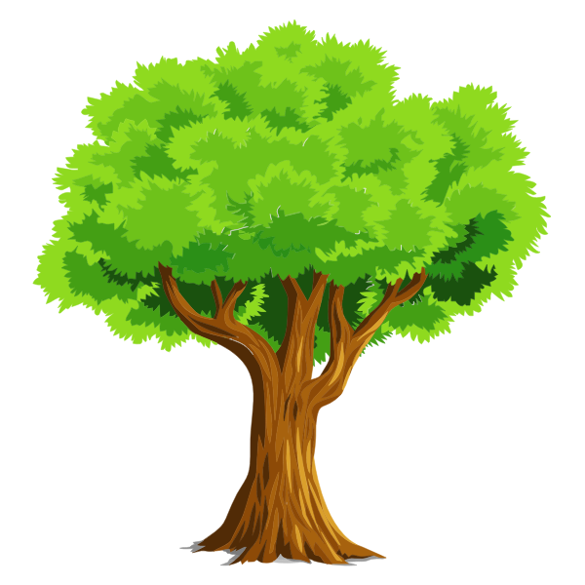
Nature As Medicine Committee-American College of Lifestyle Medicine

Slide 26
How Much Time Do We Spent Outdoors?
The Average American spends 93% of their Indoors
87% of time is spent Inside Buildings
6% of time is spent Inside Automobiles
THIS IMPLIES ONLY 7% OF TIME IS SPENT OUTDOORS!
Klepeis, Nelson, Ott et al. The National Human Activity Pattern Survey, J Expo Sci Environ Epidemiol 11, 23-252 (2001)

Slide 29
WHY IS THIS MY FAVORITE PRESCRIPTION?
COST
SIDE EFFECTS
DURATION
This Photo by Unknown Author is licensed under CC BY
Notes:
This Photo by Unknown Author is licensed under CC BY-NC
This Photo by Unknown Author is licensed under CC BY

Slide 31
Background of Shinrin-Yoku
In 1982, National Health Program in Japan was proposed for Forest Bathing by the Forest Agency of Japan
Main idea and goal was to Reduce Stress in Workers
2004-Forest Agency of Japan organized a Project Team to Investigate the Effect of Shinrin-Yoku on Human Health
1.5 Million Dollar Initial Project
One of the Key Members was Dr. Qing Li
Notes:
Agency has funded over $4 Million since 2004 for Forest Bathing research

Slide 32
Research work of Dr. Qing Li: Relationship between Shinrin-Yoku and Immune Function
It is well known that the Immune System including Natural Killer(NK) cells plays a vital role in the Defense against Bacteria, Viruses and Tumors
Already has been shown that Stress Inhibits Immune Function
?? Could Forest Environment (Shinrin-Yoku/Forest Bathing) Reduce Stress
Dr. Qing Li speculated that Forest Environment (Shinrin-Yoku) may have a Beneficial Effect on Immune Function by Reducing Stress

Slide 34
1st Forest Bathing Study in Japan/World
2005, Dr. Quin Li, Iiyama City, Ngano
Li Q er al. Forest enhances human natural killer activity and expression of anti-cancer patients, Int J Immunopathol Pharmacol. 2007; 20(2):3-8
Subjects taken to Forest for 2 Days

Slide 38
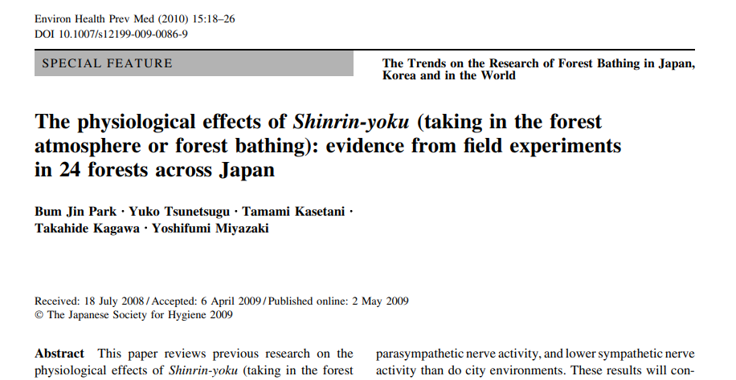

Slide 39
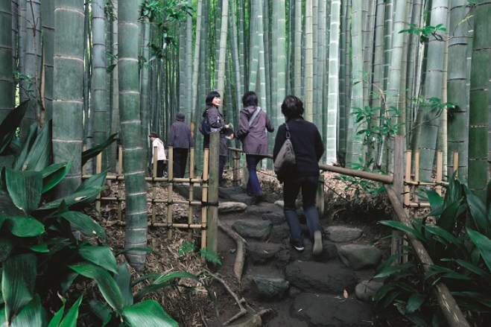
Field Experiments 24 Forests Across Japan
Each Experiment 12 Subjects (280 Total)
1st Day: 6 Subjects in Forest, 6 Subjects in Urban
Sat for 15min, Walked for 15min
2nd Day: Crossover, Each group sent to different environment
Measured: Salivary Cortisol, Blood Pressure, Pulse Rate

Slide 40
Change in Salivary Cortisol

Slide 41
CHANGE IN PULSE RATE

Slide 42
CHANGES IN BLOOD PRESSURE

Slide 43
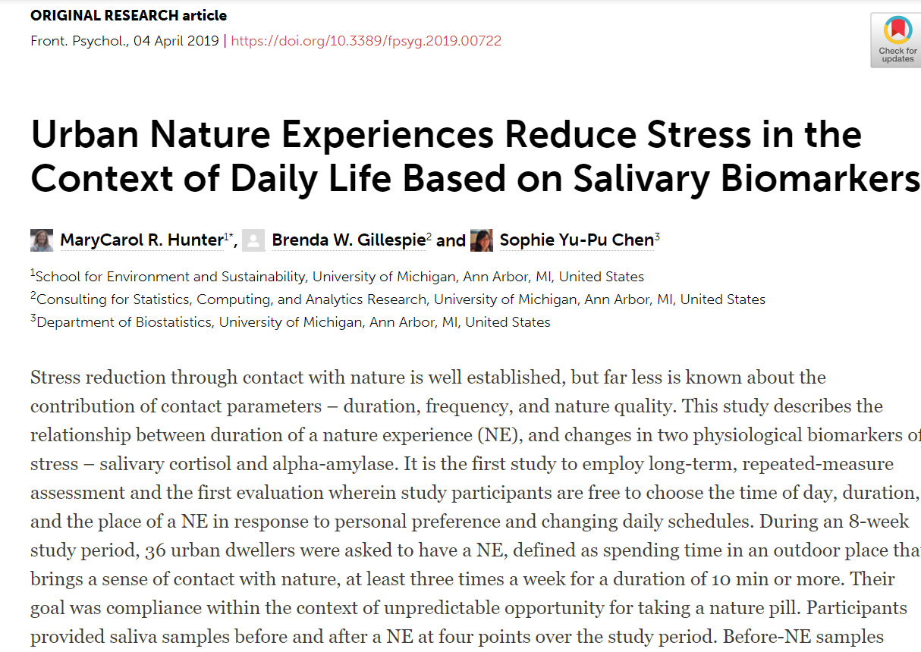

Slide 44
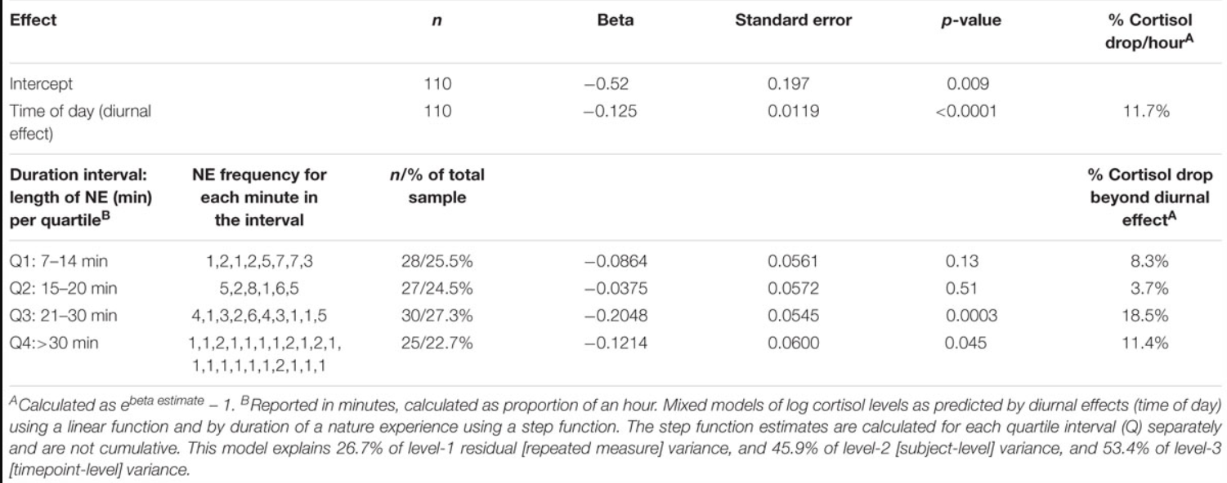

Slide 45
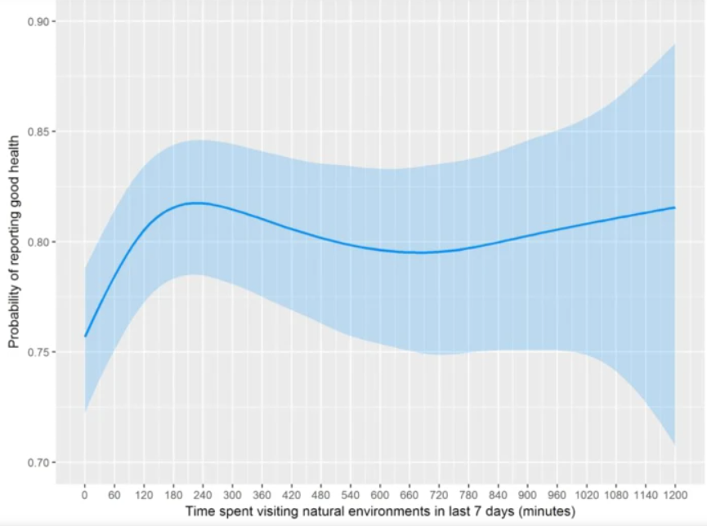
19,806 Participants
Surveyed over 7 days
Compared to No Nature contact past 7 days, likelihood of reporting Good Health or High Well-Being became significantly higher with Contact to Nature >/=120min
Positive Associations Peaked at 200-300mins per week (no further gain >300min)
Did not matter how 120min/week was achieved (one long vs several shorter episodes)

Slide 46
Rivers, Oceans, Lakes, Ponds, Streams, Fountains
BLUE SPACES FOR WELLNESS

Slide 47
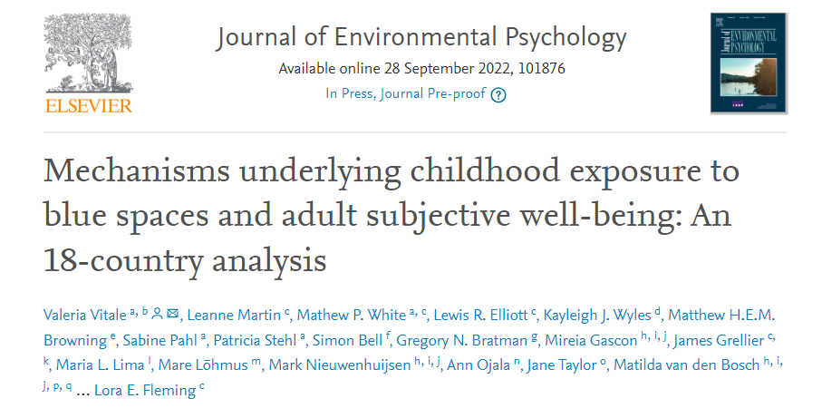
Examined the links between childhood exposure to blue spaces and adult well-being.
Four alternative conceptual models were tested using data from 18 countries.
Childhood exposure to blue spaces was associated with better adult well-being.
The association was mediated by intrinsic motivations and recent nature visits.
The pattern of associations was consistent in direction across countries.

Slide 48
Barriers to Accessing Nature

Slide 50
Benefits of Urban Green Canopy
22 studies,systematic review
Majority of studies showed reductions in the risk of all-cause mortality and total cardiovascular disease.
Greenness Exposure (per 0.1 unit increase of normalized difference vegetation index (NDVI)) was associated with a reduced risk of all-cause mortality (pooled hazard ratios (HR) (95% confidence interval (CI) = 0.99 (0.97, 1.00)) and stroke mortality (pooled HR (95% CI) = 0.77 (0.59, 1.00)) in older individuals.
Yuan, Y., Huang, F., Lin, F. et al. Green space exposure on mortality and cardiovascular outcomes in older adults: a systematic review and meta-analysis of observational studies. Aging Clin Exp Res 33, 1783–1797 (2021). https://doi.org/10.1007/s40520-020-01710-0

Slide 51
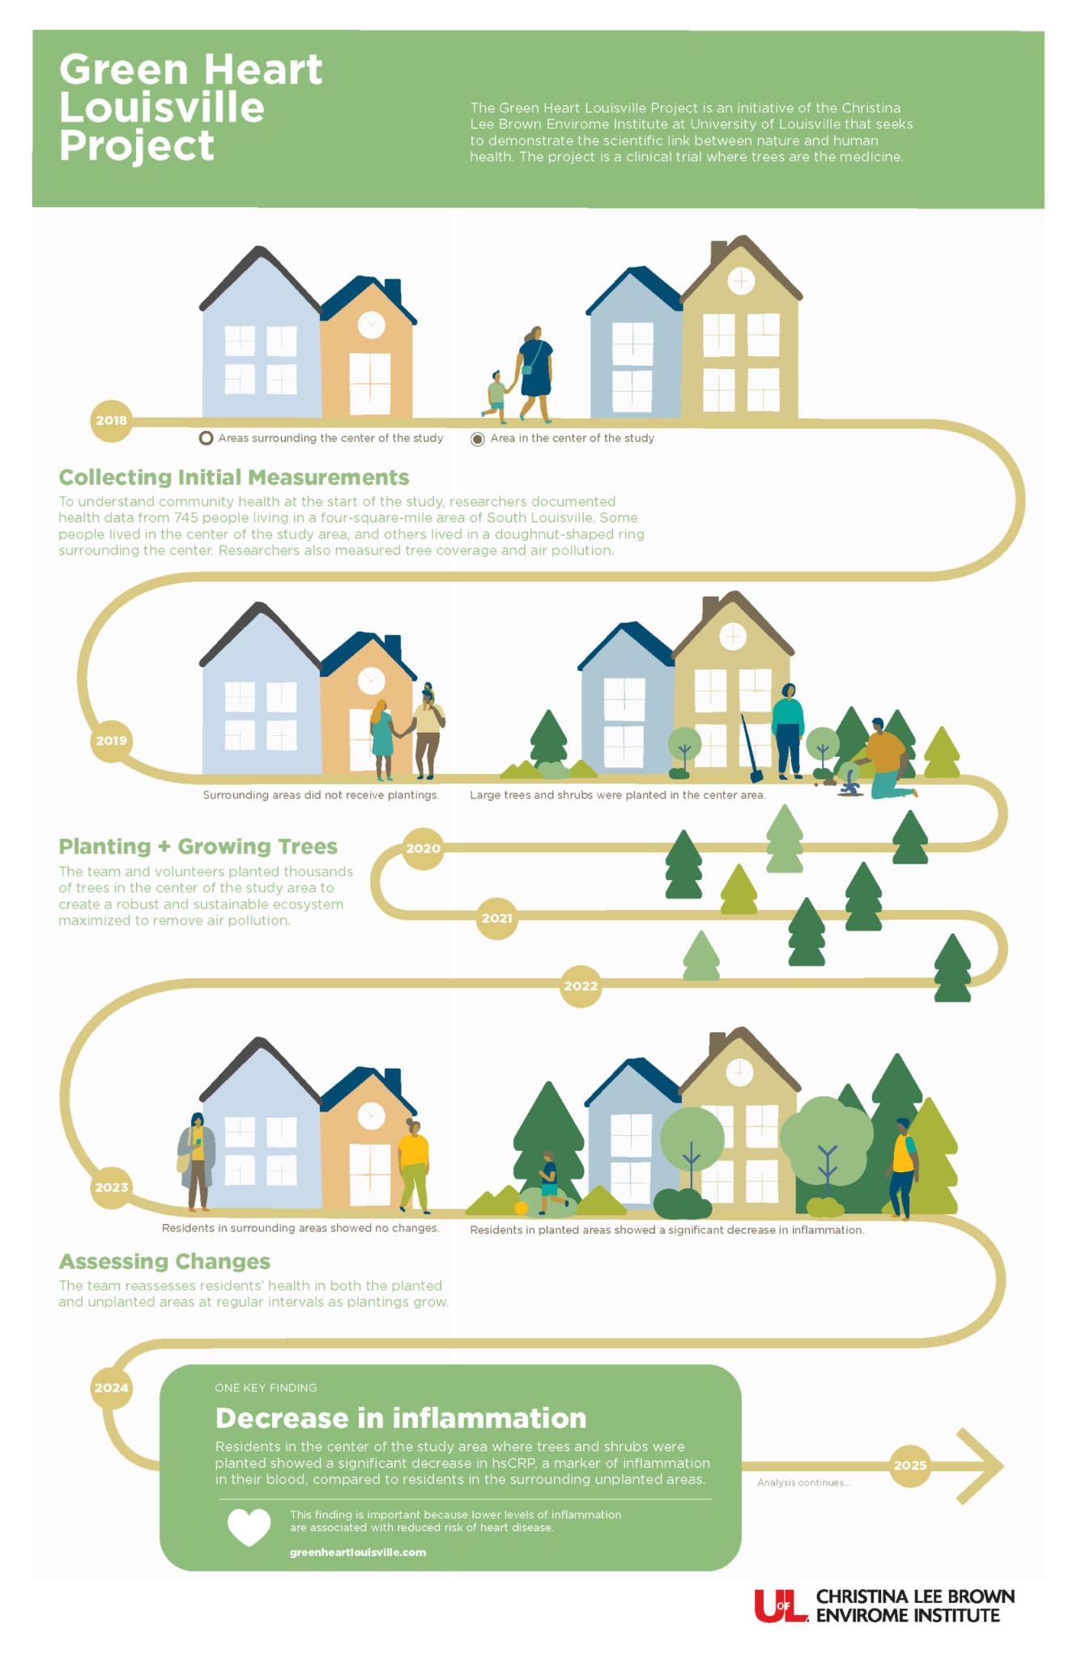
Green Heart Louisville
745 City Residents
Thousands of trees planted in center of study area
Residents in center of study area (rich in trees/shrubs)
Decrease in hsCRP levels

Slide 52
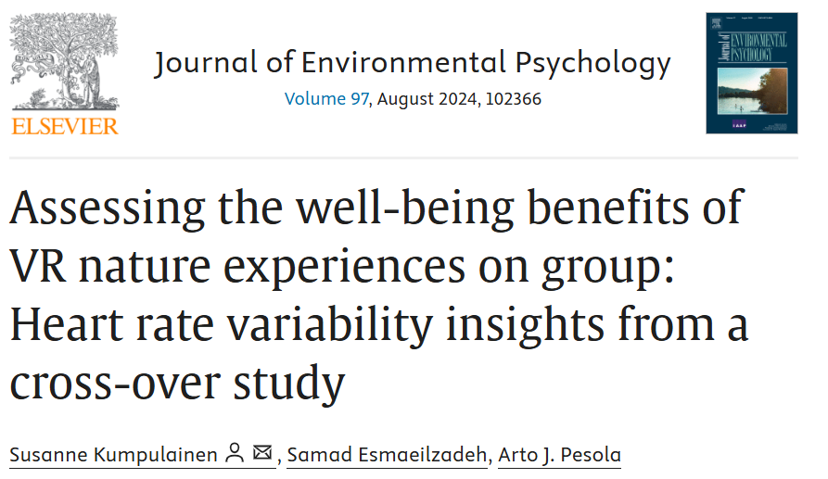
Virtual Reality Nature
Effects of virtual reality nature in real-life group settings.
Virtual reality nature raises heart rate variability.
Various psychological gains from VR nature.
Virtual reality nature aids relaxation and recovery.
https://doi.org/10.1016/j.jenvp.2024.102366

Slide 53
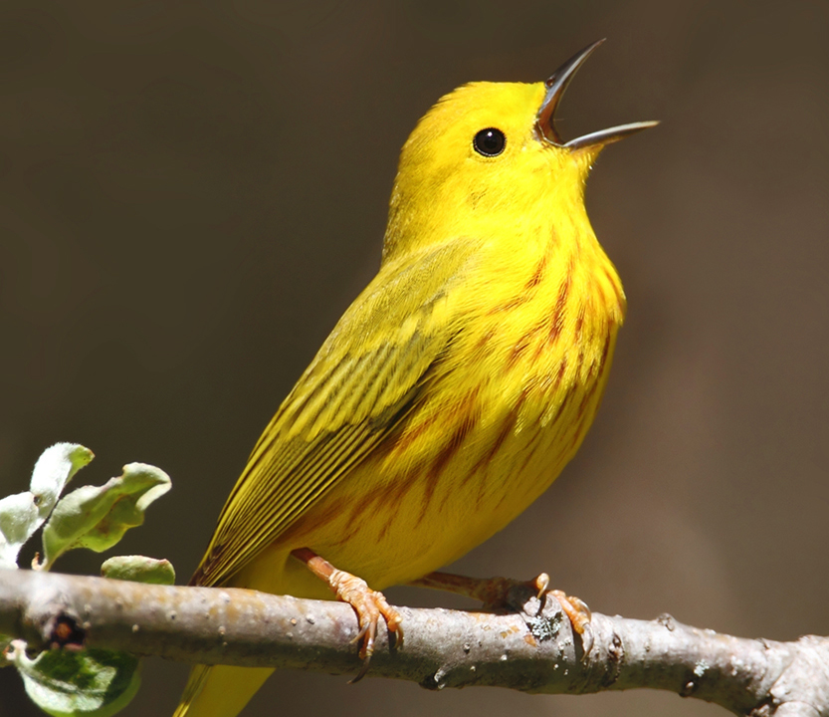
Birdsongs-Mental Health
295 Participants, 6 minute exposure to Sounds
Impact of Hearing Birds vs Traffic Sounds
Anxiety: Overall Improved with Birdsong
Paranoia: Overall Improved with Birdsong
Depression: Worsened with Traffic Sounds
Stobbe, E., Sundermann, J., Ascone, L. et al. Birdsongs alleviate anxiety and paranoia in healthy participants. Sci Rep 12, 16414 (2022). https://doi.org/10.1038/s41598-022-20841-0

Slide 54
Viewing Nature
Post Cholecystectomy Patients
23 patients-> Window with a View of a Natural Setting
23 patients-> Window Facing a Brick Wall
Patients with View of Nature:
Shorter Hospital Stays
Fewer Negative Evaluative Comments in Nurse’s Notes
Required Less Pain Medication
Ulrich RS. View through a window may influence recovery from surgery. Science. 1984 Apr 27;224(4647):420-1. doi: 10.1126/science.6143402. PMID: 6143402.

Slide 55
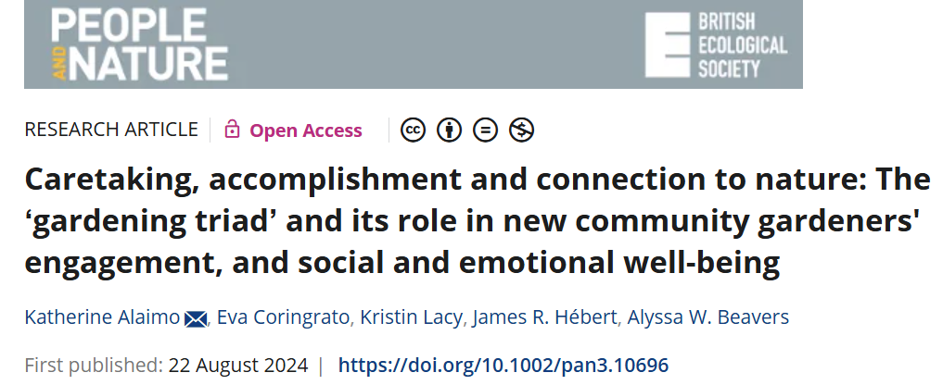
Urban Gardening

Slide 56
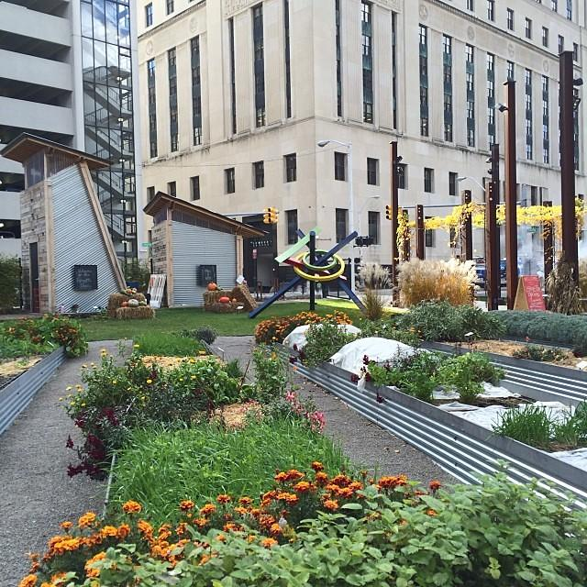
Enhanced Well-Being: Gardening improved health through social support, overcoming challenges, and increased physical activity and food production.
'Gardening Triad' Impact: Caretaking, accomplishment, and nature connection fostered joy, purpose, and social bonds.
Community Benefit: Gardening with others amplified social and emotional well-being.
https://doi.org/10.1002/pan3.10696

Slide 57
Nature is Nurture

Slide 58
BIOPHILIA
Term originated 1973 by Erich Fromm (social psychologist). Also coined by E.O. Wilson
Described as “The Passionate Love of Life and of all that is Alive; it is the Wish to further Growth, whether in a Person, Plant, an Idea or a Social Group”
Innate Emotional Connection of Human Beings to Other Living Organisms
Not only aids in Survival, but also broader Human Fulfillment
Natural Environments are one of the few places to Experience All 5 Senses

Slide 59
Attention Restoration Theory
ART suggests the ability to concentrate may be restored by exposure to natural environments
ART proposes that individuals benefit from the chance to:
“Be Away” from everyday stresses
Experience expansive spaces and contexts
Engage in activities that are “compatible” with our intrinsic motivations
Critically experience stimuli that are “softly fascinating”
This combination of factors encourages “involuntary” or “indirect attention” and enables our “voluntary” or “directed” attention capacities to recover and restore
Ohly, H., White, M. P., Wheeler, B. W., Bethel, A., Ukoumunne, O. C., Nikolaou, V., & Garside, R. (2016). Attention Restoration Theory: A systematic review of the attention restoration potential of exposure to natural environments. Journal of Toxicology and Environmental Health, Part B, 19(7), 305–343. https://doi.org/10.1080/10937404.2016.1196155

Slide 61
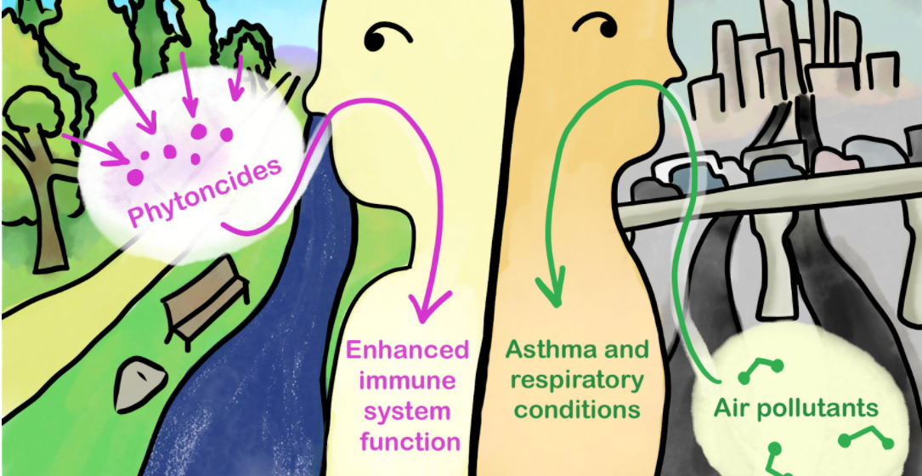

Slide 62
Dr. Li wanted to further test exposure to Phytoncides
12 Subjects “locked” in Hotel Rooms for 3 Nights
Some Rooms were “rigged” with a Humidifier to Vaporize Stem Oil from Hinocki Cypress Tress
Other Rooms Emitted “Eau-De-Nothing”
Cyprus Sleepers experienced a 20 Percent INCREASE in NK Cells during their stay. Also felt less fatigued
Control Group saw NO changes
Li Q, Kobayashi M, Wakayama Y, Inagaki H, Katsumata M, Hirata Y, Hirata K, Shimizu T, Kawada T, Park BJ, Ohira T, Kagawa T, Miyazaki Y. Effect of phytoncide from trees on human natural killer cell function. Int J Immunopathol Pharmacol. 2009 Oct-Dec;22(4):951-9. doi: 10.1177/039463200902200410. PMID: 20074458.

Slide 63
Deprescribing with Nature
T

Slide 64
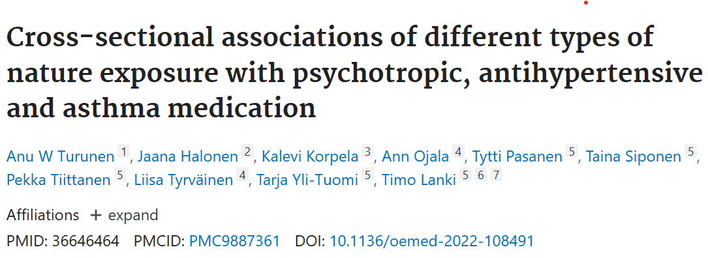
Results
More frequent visits to Green Spaces (3-4x/week)
Decreased need for Medications related to:
Mental Health Conditions
High Blood Pressure
Asthma
Higher nature exposure->Greater Likelihood of reducing or stopping medications compared to individuals with less exposure
Turunen AW, Halonen J, Korpela K, et alCross-sectional associations of different types of nature exposure with psychotropic, antihypertensive and asthma medicationOccupational and Environmental Medicine 2023;80:111-118.

Slide 65
NATURE EFFECTS ON THE GUT MICROBIOME

Slide 66
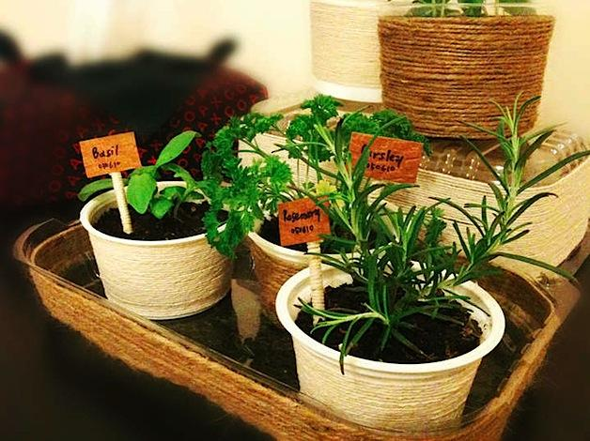
Indoor Gardening
Healthy urban adults participated in urban indoor gardening using either microbially rich or poor growing medium.
Participants were instructed to monitor, harvest, and consume produce daily.
Gardening with microbially rich growing medium diversified skin microbiota and increased anti-inflammatory IL-10 levels in blood.
No changes in skin microbiota or blood cytokine levels were observed when microbially poor growing medium was used.
https://doi.org/10.1016/j.envint.2024.108705

Slide 67
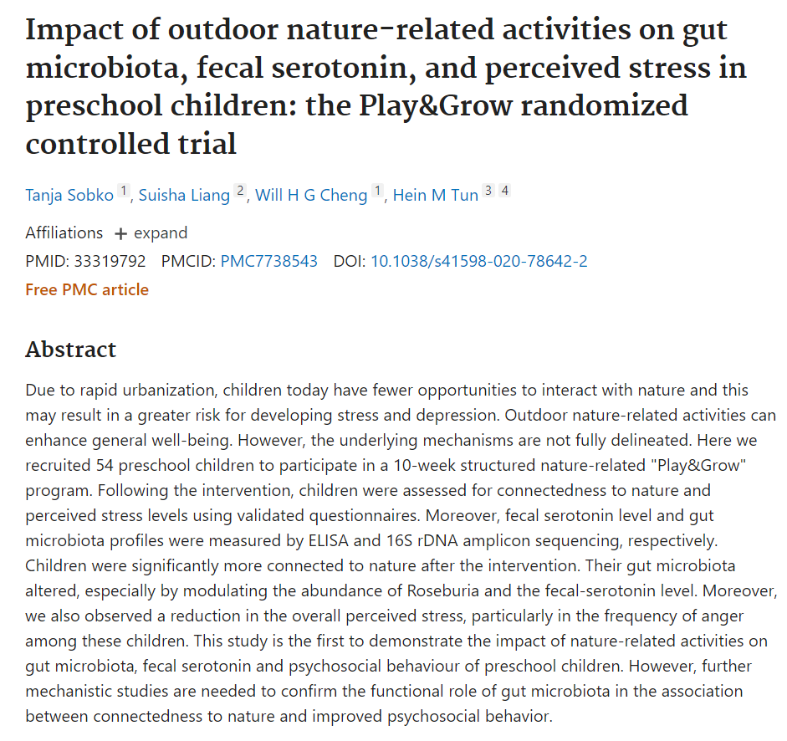

Slide 68
RESULTS
54 Preschool age children
10 week Nature-Related structured “Play and Grow” program
More significant Connection to Nature
Decreased perceived overall Stress and Anger
Alteration of Gut Microbiome:
Increase in Roseburia (produces Butyrate)
Increase in Fecal Serotonin Level

Slide 69
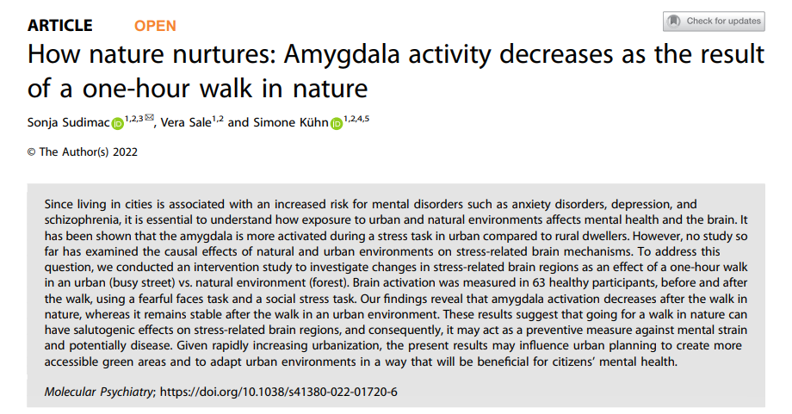

Slide 70
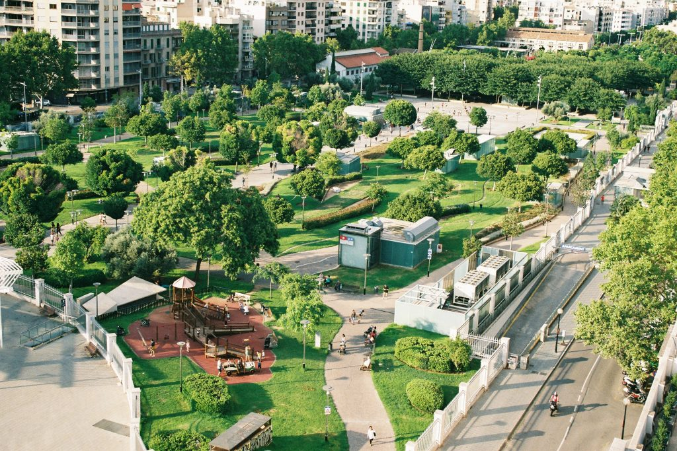
GREENSPACE AND TYPE 2 DIABETES
Cross-Sectional studies
Green Space is Inversely related to Type 2 Diabetes
Neighborhoods with more tree canopy and open grass reduce fatal and non-fatal cardiovascular events in people with T2DM.
https://doi.org/10.2337/dc13-1325
https://doi.org/10.1016/j.healthplace.2023.103045
Notes:
This Photo by Unknown Author is licensed under CC BY

Slide 71
Green Spaces & Neurodegenerative Diseases
62 million Medicare beneficiaries
Results revealed that older adults who lived in a Zip code with more Green Space had a lower rate of hospitalization for Parkinson’s disease, Alzheimer’s Disease and related dementias such as vascular dementia and Lewy body dementia.
Blue Space — bodies of water such as lakes, rivers and oceans — and the amount of land dedicated to parks in a given Zip code were also associated with fewer hospital admissions for Parkinson’s disease, but not for Alzheimer’s disease and related dementias.
Klompmaker JO, Laden F, Browning MHEM, et al. Associations of Greenness, Parks, and Blue Space With Neurodegenerative Disease Hospitalizations Among Older US Adults. JAMA Netw Open. 2022;5(12):e2247664. doi:10.1001/jamanetworkopen.2022.47664
Notes:
This Photo by Unknown Author is licensed under CC BY-NC-ND

Slide 72
Green Spaces and Stroke/CVA
Retrospective 1:4 matched case-control study involving 1174 stroke and 4696 control patients over a 3-year period from Milwaukee County, Wisconsin
Greenspace was determined using normalized difference vegetation index (NDVI) for a 250-meter radius surrounding a subject’s residence. The area deprivation index (ADI) for the subject’s residence was obtained from the Neighborhood Atlas®
NDVI and stroke risk were inversely correlated with 19% lowered odds of stroke for patients living in the highest greenspace quartile compared to the lowest quartile
Patients living in the most deprived ADI quartile had 28% greater stroke risk than those living in the least deprived ADI quartile
Cheruvalath H, Homa J, Singh M, Vilar P, Kassam A, Rovin RA. Associations Between Residential Greenspace, Socioeconomic Status, and Stroke: A Matched Case-Control Study. J Patient Cent Res Rev. 2022 Apr 18;9(2):89-97. doi: 10.17294/2330-0698.1886. PMID: 35600229; PMCID: PMC9022714.

Slide 73
Green Spaces & Telomere Length
Greenspace exposure found to have an association with telomere length in the NHANES sample.
•Greater neighborhood greenspace associated with longer telomere length considering individual factors.
•When including contextual factors of the neighborhood the relationship becomes non-significant
•Findings point to complex relationship between greenspace exposure and telomere length
https://doi.org/10.1016/j.scitotenv.2023.167452
Notes:
This Photo by Unknown Author is licensed under CC BY-NC-ND

Slide 74
PRA - Nature Prescribed (parkrxamerica.org)

Slide 75
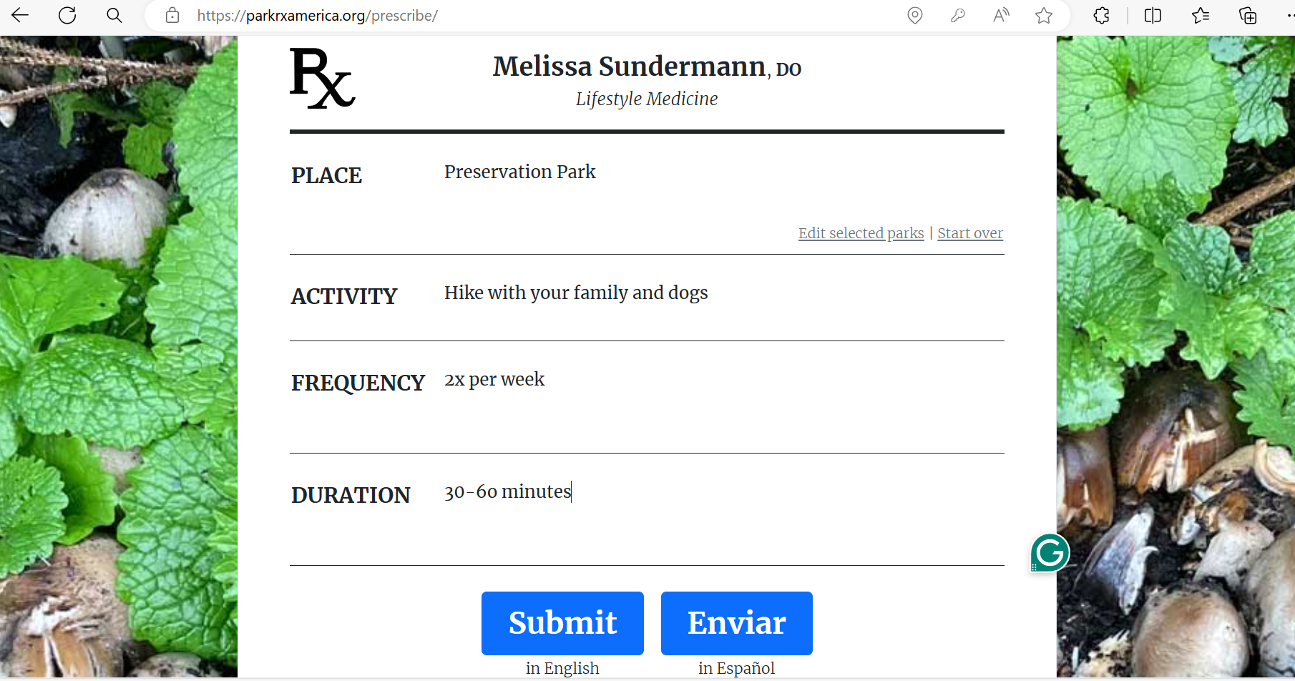

Slide 76
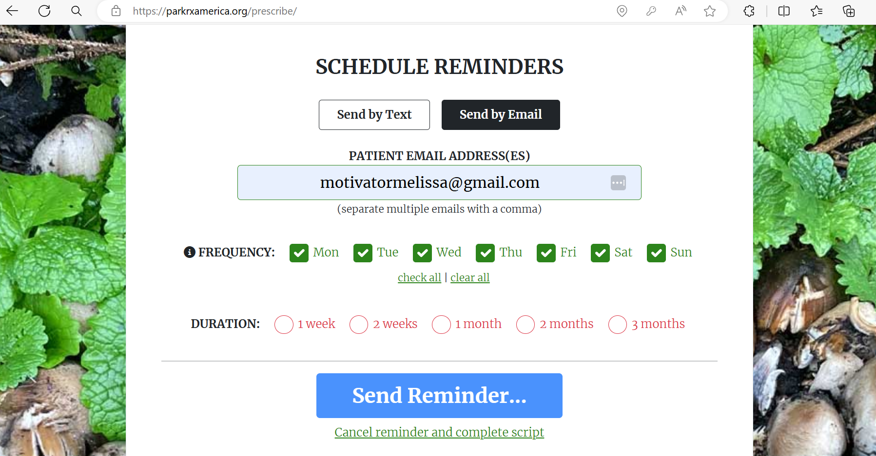

Slide 77
PaRx: A Prescription for Nature (parkprescriptions.ca)

Slide 78
Launched in November 2020
Canada’s 1st Nature Prescription
Recommend spending a Minimum of 2 hours/week in Nature at least 20minute Intervals
PaRX Medical Professionals can prescribe “Adult Parks Canada Discovery Pass”
Pass covers Year-Long Admission to over 80 Destinations Across Canada

Slide 79
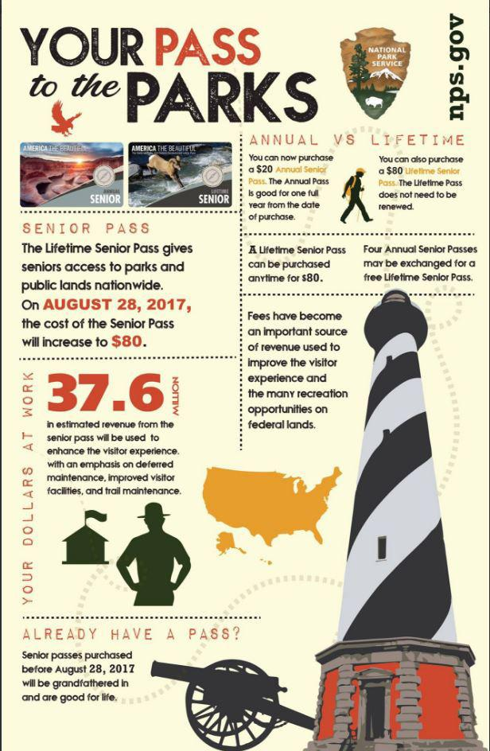

Slide 80
THANK YOU!

Slide 81
www.giamerlo.com
Gia Merlo, MD, MBA, MEd
Clinical Professor of Psychiatry
NYU Grossman School of Medicine
giamerlo.com
Melissa Sundermann, DO, FACOI, DipABLM, FACLM
Lifespan Medicine Physician
motivatormelissa@gmail.com

